Slide 1
Algorithm Analysis
TUAN NGUYEN

Slide 2
OUTLINE
Experimental Studies
Functions in analysis
Big-O notation
Prefix Averages example

Slide 3
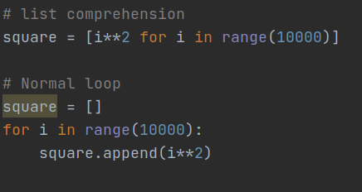
Compare algorithms

Slide 4
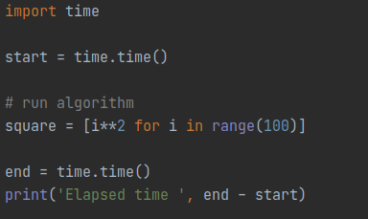
Experimental Studies
Python code to calculate the running time of algorithm

Slide 5
Challenges of Experimental Analysis
There are three major limitations:
Different hardware and software environments.
Experiments can be done only on a limited set of test inputs.
An algorithm must be fully implemented in order to execute it to study its running time experimentally.
=> need to analyze the efficiency of algorithms.

Slide 6
Primitive Operations
We define a set of primitive operations:
Assigning an identifier to an object
Performing an arithmetic operation (for example, adding two numbers)
Comparing two numbers
Accessing a single element of a Python list by index
Calling a function (excluding operations executed within the function)
Returning from a function.

Slide 7
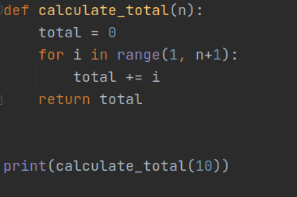
Measuring Operations as a Function of Input Size
To capture the order of growth of an algorithm’s running time, we will associate,
with each algorithm, a function f (n) that characterizes the number of primitive
operations that are performed as a function of the input size n.

Slide 8
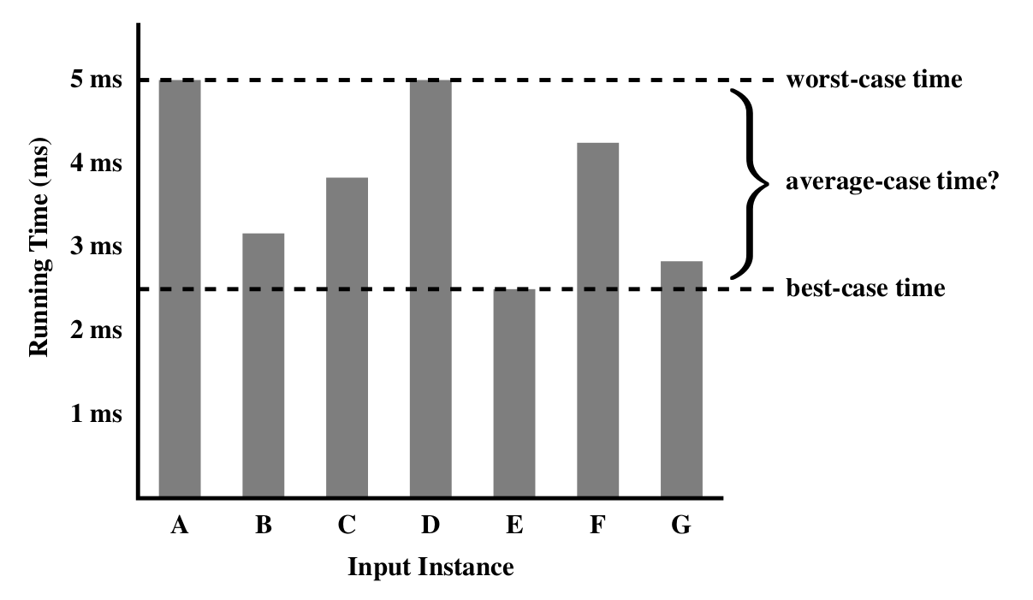
Worst-case time

Slide 9
Functions in Analysis of Algorithms
The Constant Function
The Logarithm Function
The Linear Function
The N-Log-N Function
The Quadratic Function
The Cubic Function and Other Polynomials
The Exponential Function

Slide 10
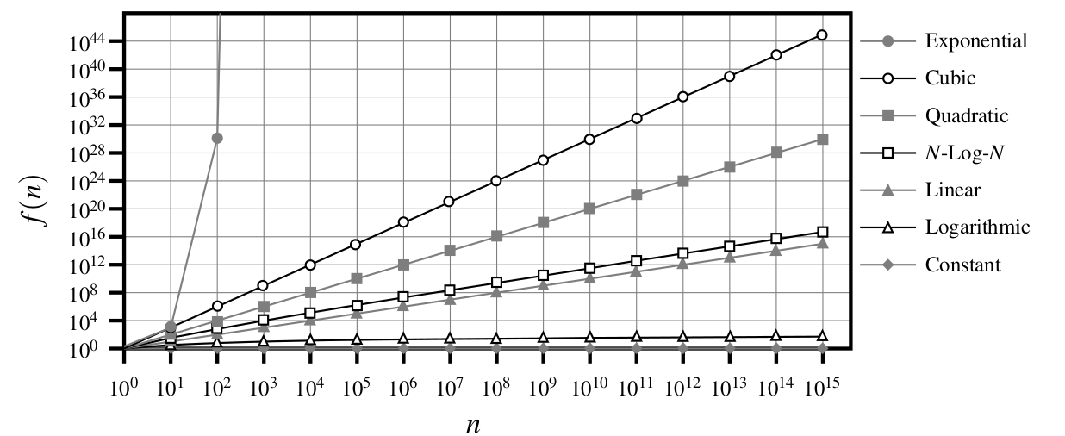
Compare Growth Rates

Slide 11
Big-Oh Notation
Let f (n) and g(n) be functions mapping positive integers to positive real numbers.
We say that f (n) is O(g(n)) if there is a real constant c > 0 and an integer constant
n₀ ≥ 1 such that:
f(n) ≤ cg(n), for n ≥ n₀.
This definition is often referred to as the “big-Oh” notation, for it is sometimes pronounced as “ f (n) is big-Oh of g(n).”

Slide 12
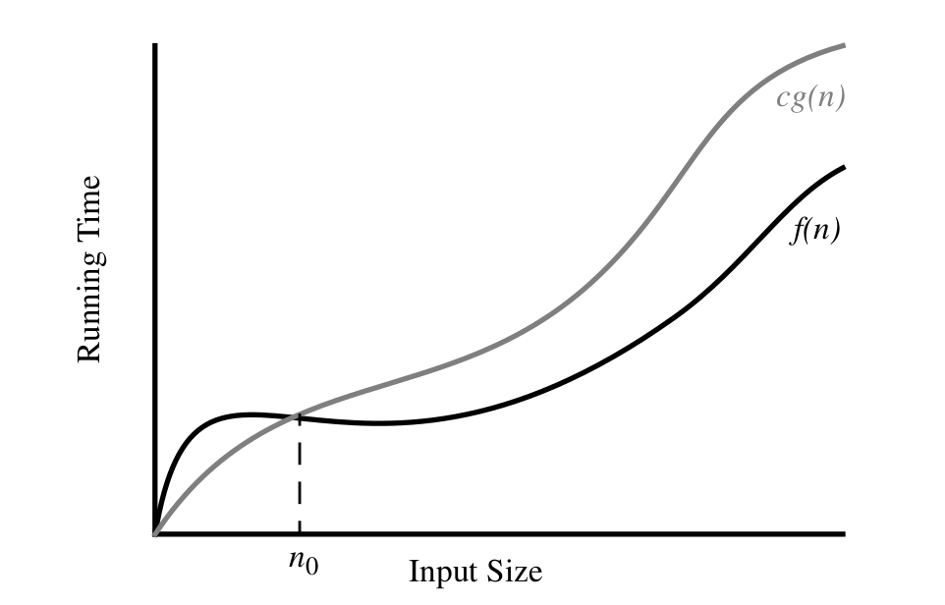
Big-Oh Notation (1)
Proof: The function 8n + 5 is O(n).

Slide 13
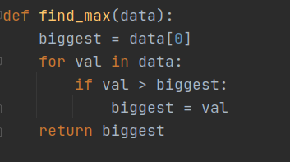
Big-Oh Notation (2)
The big-Oh notation is used widely to characterize running times and space bounds in terms of some parameter n.

Slide 14
Exercise
Find the Big-Oh of these functions in simplest terms:
5n⁴ + 3n³ + 2n² + 4n + 1
f (n) = a₀ + a₁n + · · · + a_{d}n^{d}
5n² + 3n log n + 2n + 5
3 log n + 2
2n + 100log n

Slide 15
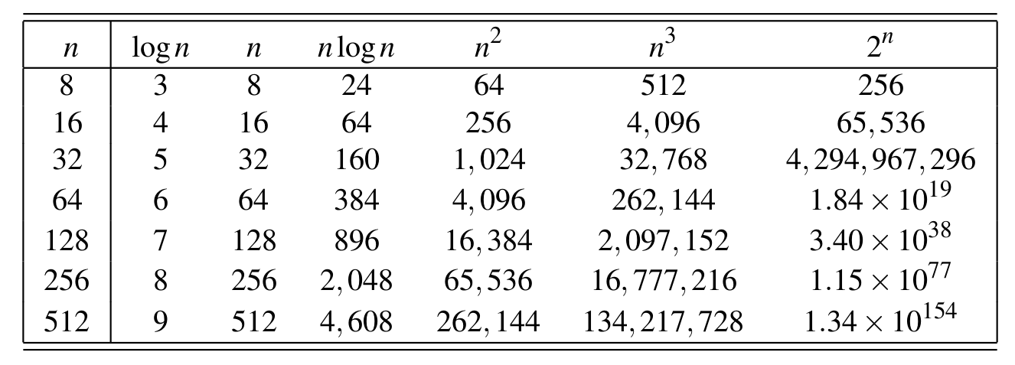
Comparative Analysis

Slide 16
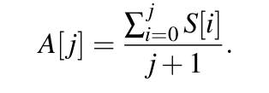
Prefix Averages
Given a sequence S consisting of n numbers, we want to compute a sequence A such that A[j] is the average of elements S[0], . . . , S[ j], for j = 0, . . . , n − 1, that is:
def prefix_average(S):
A = []
# algorithm
return A

Slide 17
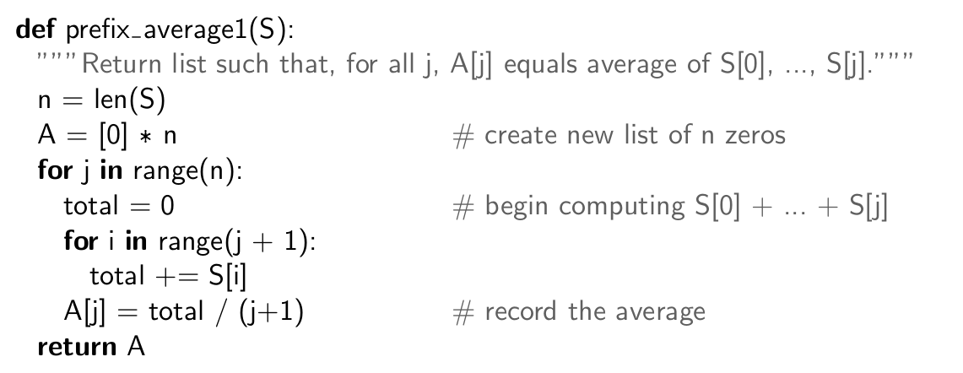
Prefix Averages (1)

Slide 18
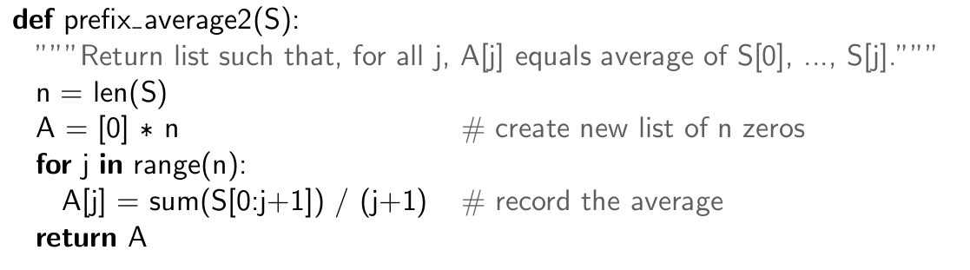
Prefix Averages (2)

Slide 19
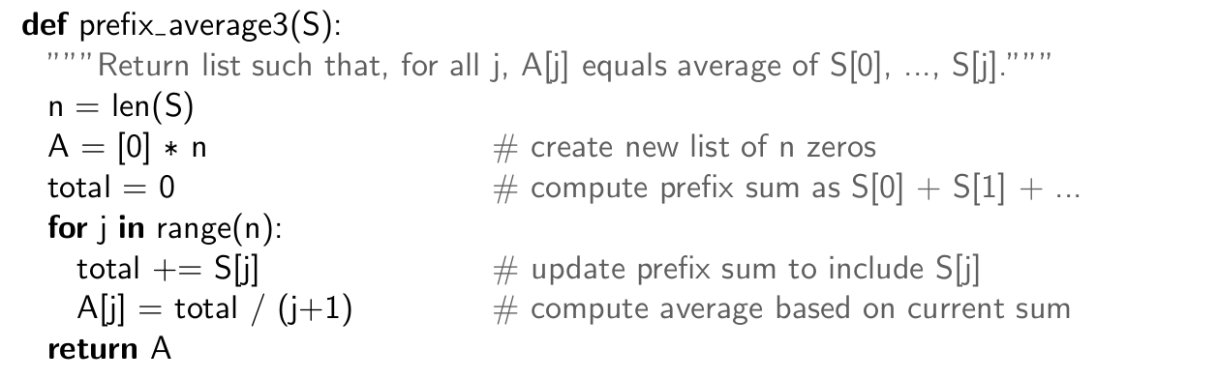
Prefix Averages (3)

Slide 20
Exercise
Given a sorted list (number), write a function to find whether the element x in list number. Analyze the running time of this algorithm.
Describe an algorithm for finding both the minimum and maximum of n numbers using fewer than 3n/2 comparisons. (Hint: First, construct a group of candidate minimums and a group of candidate maximums.)

